Slide 1
MSE 3109: Kinetic Process in Engineering Materials
Instructor: Yuntian Zhu
Office: R7182, Ph: 3442-2457
y.zhu@cityu.edu.hk
Lecture 1: Introduction & Diffusion I
Notes:
Text book,
Office hour, by appointment

Slide 2
Textbook and Reference
Textbook: “Phase Transformations in Metals and Alloys”, David A. Porter, Kenneth E. Easterling, Mohamed Y. Sherif, 3nd ed., CRC Press, 2009. (TN690.P67 2009).
Homework assignment will be from this textbook
References
Dennis Ready, Kinetics in Materials Science and Engineering, SBN-13: 978-1482235661

Slide 3
Course Administration Matters
Grade calculation: Mid term counts for 30%, Lab counts for 10%, & Final exam counts for 60%
You must obtain at least 30 marks in the final exam to pass the course
You have to do two labs.

Slide 4
Active student participation in class required
A dice will be rolled to determine who participates
0.2% will be deducted if you are not present in the class to answer a quiz;
0.2% will be given if you give the right answer
0.2% will be given to a volunteer who gives the right answer
No credit will be given or deducted if you give a wrong answer
No one get called more than twice for each lecture
Credit earned from quizzes will be incorporated into the mid-term score

Slide 5
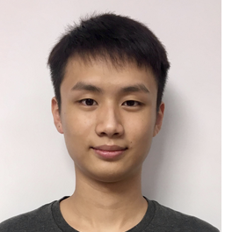
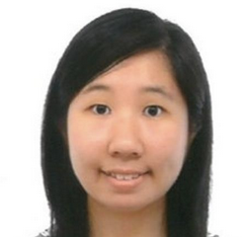


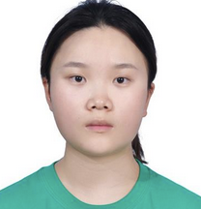
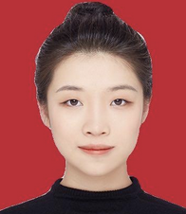
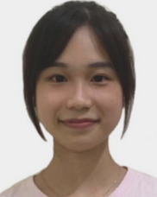
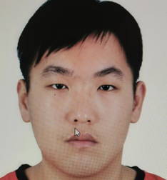
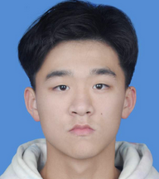


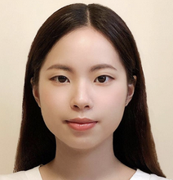


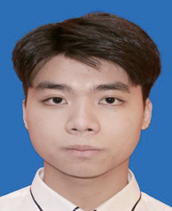


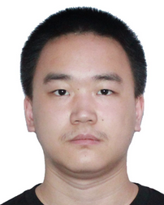
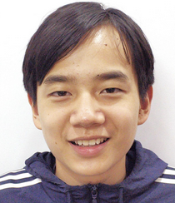

Quiz Coordinate
1-1. Chan Chun Kit | 1-2.Kwok Wing Tung | 1-3. Lee Ka Man | 1-4. Leung chi Hon | 1-5. Li Lei | 1-6. Li Shiyin
2-1. Li Shuk Yee | 2-2 Li Yipeng | 2-3. Lin Zhixing | 2-4. Liu Da Hong | 2-5 Luk Chun Ming | 2.6 Peng Hai Lan
3-1 Tsang Yuen Ching | 3-2 Tsoi Tsz Yin | 3-3 Wang Bofan | 3-4 Wu Hao Chun | 3-5 Yi JInghao | 3-6 Yue Zijun
4-1 Zhao Yuxuan | 4-2 Zhu Sihong | 4-3 | 4-4 | 4-5 | 4-6

Slide 6
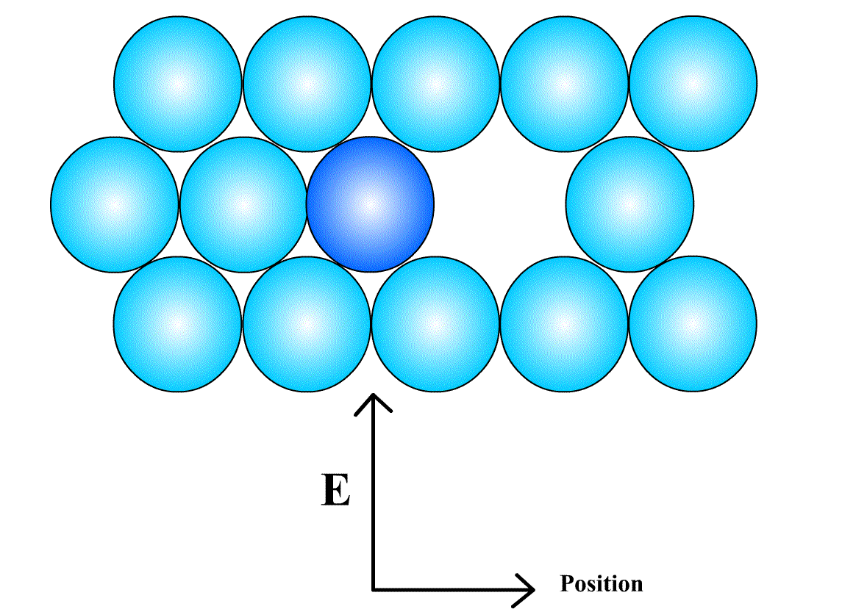
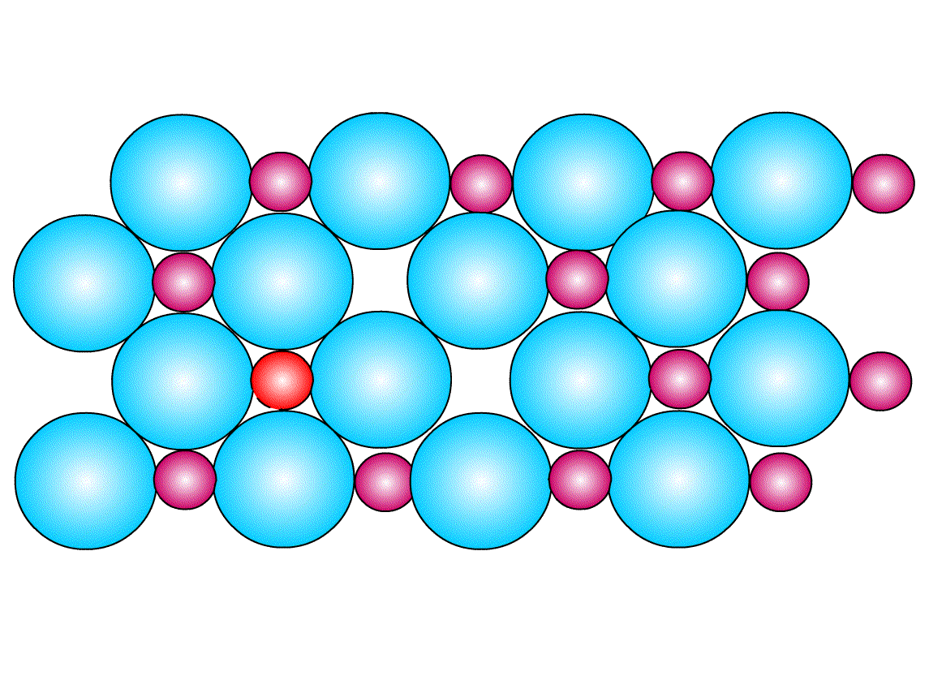
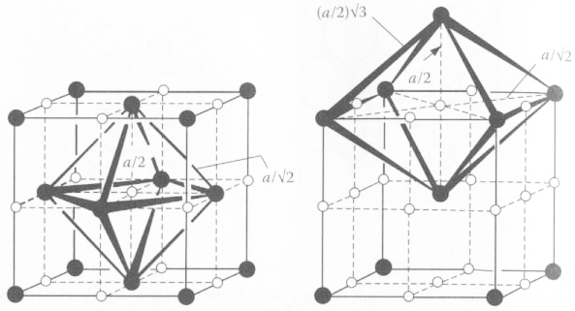
Diffusion I
Diffusion is driven by Gibbs free energy (Fig. 2.1)
Vacancy mechanism Interstitial mechanism
Notes:
The mean vibrational energy = 3 kT
Quiz: Octohedral sites in fcc; tetrahedral sites in fcc; octahedral sites in bcc, Fig. 2.3

Slide 7
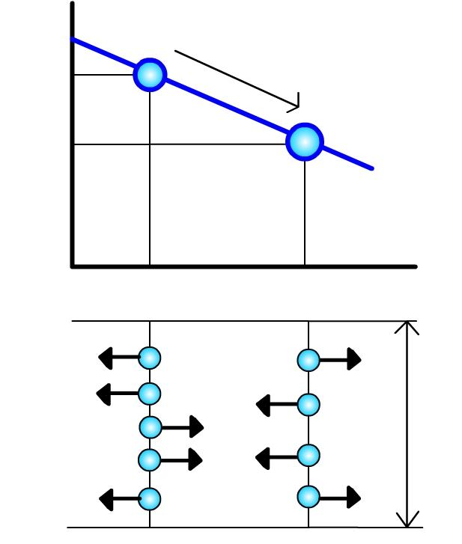
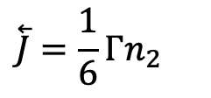
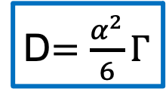
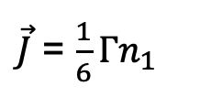

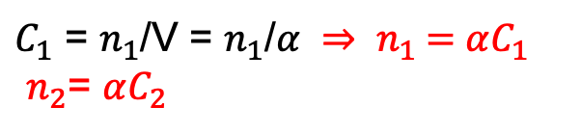
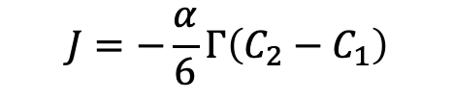
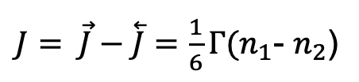
Steady state diffusion (Interstitial Diffusion)
C is concentration, D is diffusion coefficient
Γ Is the solute atom jumping frequency
Fick’s First Law:
$\vec{J}$ = $\frac{1}{6}Γn_{1}$
J (flux) = Net flow of atoms per unit area per unit time
$$\overset{⃖}{J}=\frac{1}{6}Γn_{2}$$
C₁
Solute atom flow
Concentration
Of diffusing
atoms
C₂
$J= \vec{J}−\overset{⃖}{J}=\frac{1}{6}Γ(n_{1}$- $n_{2}$)
α
$C_{1}$ = $n_{1}$/V = $n_{1}$/$α ⇒ n_{1}$ = $αC_{1}$
$n_{2}$= $αC_{2}$
n₁
n₂
Distance x
$$J=−\frac{α}{6}Γ\left(C_{2}−C_{1}\right)$$
Diffusing
atoms
Unit
Area
$J=−\frac{α^{2}}{6}Γ\frac{\left(C_{2}−C_{1}\right)}{α}$ = -$D\frac{dC}{dx}$
D$=\frac{α^{2}}{6}Γ$
1
2
Area = 1
Notes:
Fick’s first law of diffusion
Unit of J: quantity/m²s
Γ is the frequency of successful jumps
C₁=n₁/α, C₂ = n₂/α
n₁-n₂=α(c₁-c₂)
=α² (c₁-c₂)/α
=-α² dC/dx

Slide 8

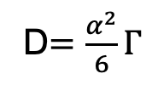
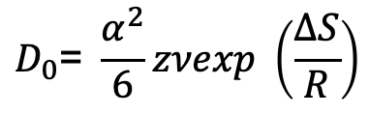
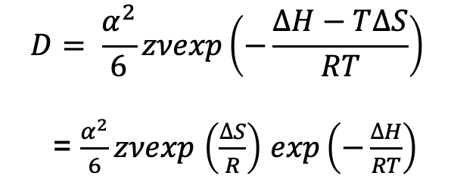
Effect of Temperature
D$=\frac{α^{2}}{6}Γ$
$$∆G=∆H−T∆S$$
$$D= \frac{α^{2}}{6}zνexp\left(−\frac{∆H−T∆S}{RT}\right)$$
= $\frac{α^{2}}{6}zνexp$ $\left(\frac{∆S}{R}\right)$ $exp\left(−\frac{∆H}{RT}\right)$
z is the coordinate number (#of interstitial sites to jump to)
v is the vibrational frequency
$$D_{0}\text{= }\frac{α^{2}}{6}zνexp \left(\frac{∆S}{R}\right)$$
Q=ΔH activation enthalpy
Notes:
Q=ΔH, G=H-TS, Rate controlled process, definition of Q,
Z = # of sites for jump
v = vibrational frequency

Slide 9
Statistical Basis of Diffusion
- Deviation from the Assumptions
Atomic jumps are not completely random nor is it independent of concentration.
  In non-cubic lattices, the probabilities of jumps in different crystallographic directions are different
  D is usually not independent of composition, e.g. carbon in austenite rises from 2.5×10⁻¹¹ m²S⁻¹ to 7.7 ×10⁻¹¹ m²S⁻¹ when C content increases from 0.15 wt% to 1.4 wt% due to the increased elastic strain in the Fe lattice with higher C content

Slide 10
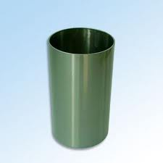
Steady state diffusion (for tutorial)
Example: diffusion of C through a cylinder :
A cylinder 0.01 mm thick of iron has a carbon concentration of 2.5×10²² atoms/cm³ on one side and 8×10²⁰ atoms/cm³ on the other side. The diffusion coefficient of carbon in iron has constants of Q=142 kJ/mol and D_{o}=2x10⁻⁵ m²/s and R = 8.314 J/(mol•K), At the temperature of 927°C, calculate 1) the concentration gradient of carbon, 2) The diffusion coefficient at 927°C, 3) The flux of carbon through the foil at 927°C:
Notes:
Described by Fick’s first law
dC/dx = (0-C_{H})/t, t is thickness

Slide 11
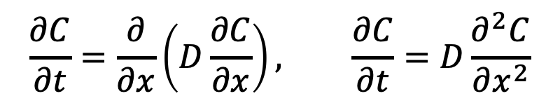
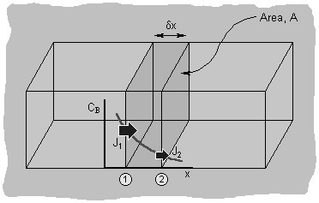
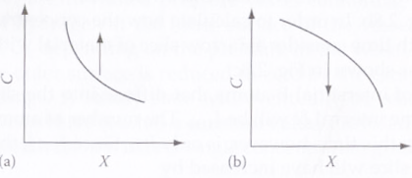
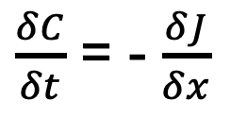
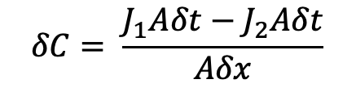
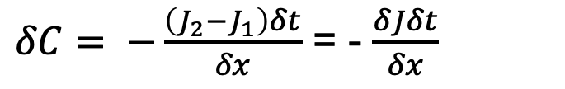
Non-steady state Diffusion: Fick’s Second Law
In δt, the change in C:
$$δC= \frac{J_{1}Aδt−J_{2}Aδt}{Aδx}$$
V = Aδx
$δC= −\frac{\left(J_{2}−J_{1}\right)δt}{δx}$ = - $\frac{δJδt}{δx}$
$\frac{δC}{δt}$ = - $\frac{δJ}{δx}$
Meaning of curvature
Notes:
In δt, the change in C can be described as
(a) +, solute atoms are accumulative in the volume (fast diffuse-in, slower diffuse-out).

Slide 12
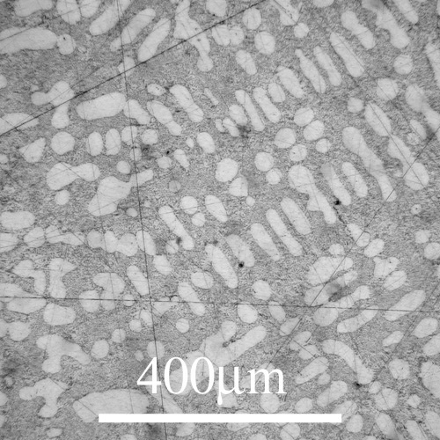
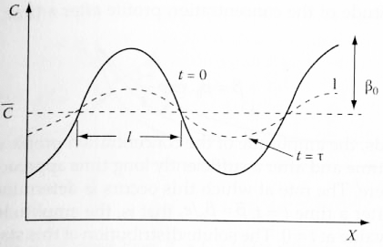
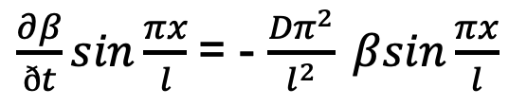
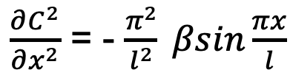
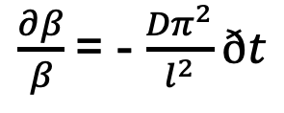
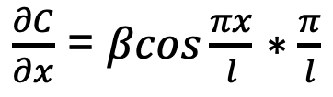
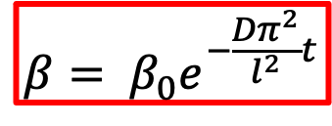
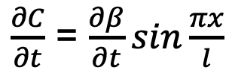
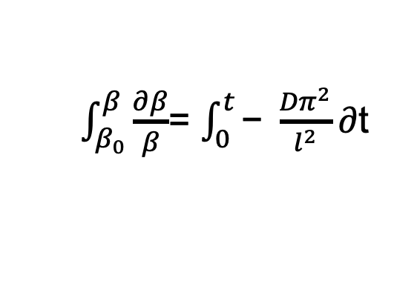
Example 1: Homogenization
$\frac{∂β}{ðt}sin\frac{πx}{l}$= - $\frac{{Dπ}^{2}}{l^{2}} βsin\frac{πx}{l}$
$\frac{∂β}{β}$= - $\frac{{Dπ}^{2}}{l^{2}}ðt$
$\frac{∂C}{∂t}$ = $\frac{∂β}{∂t}sin\frac{πx}{l}$
$\int_{β_{0}}^{β}{\frac{∂β}{β}}$= $\int_{0}^{t}{\text{− }\frac{{Dπ}^{2}}{l^{2}}∂\text{t}}$
$\frac{∂C}{∂x}$ = $βcos\frac{πx}{l}$ $∗\frac{π}{l}$
$$β= β_{0}e^{−\frac{{Dπ}^{2}}{l^{2}}t}$$
$\frac{∂C^{2}}{∂x^{2}}$ = - $\frac{π^{2}}{l^{2}} βsin\frac{πx}{l}$
Notes:
is a function of t

Slide 13
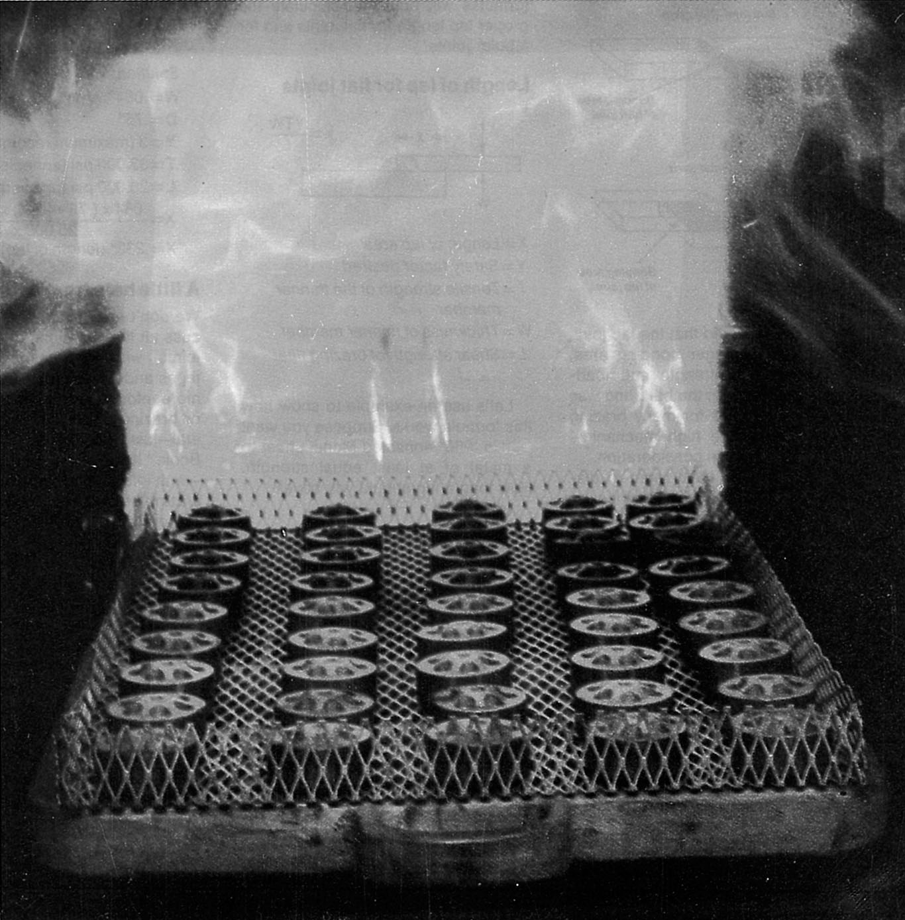
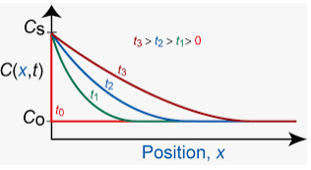
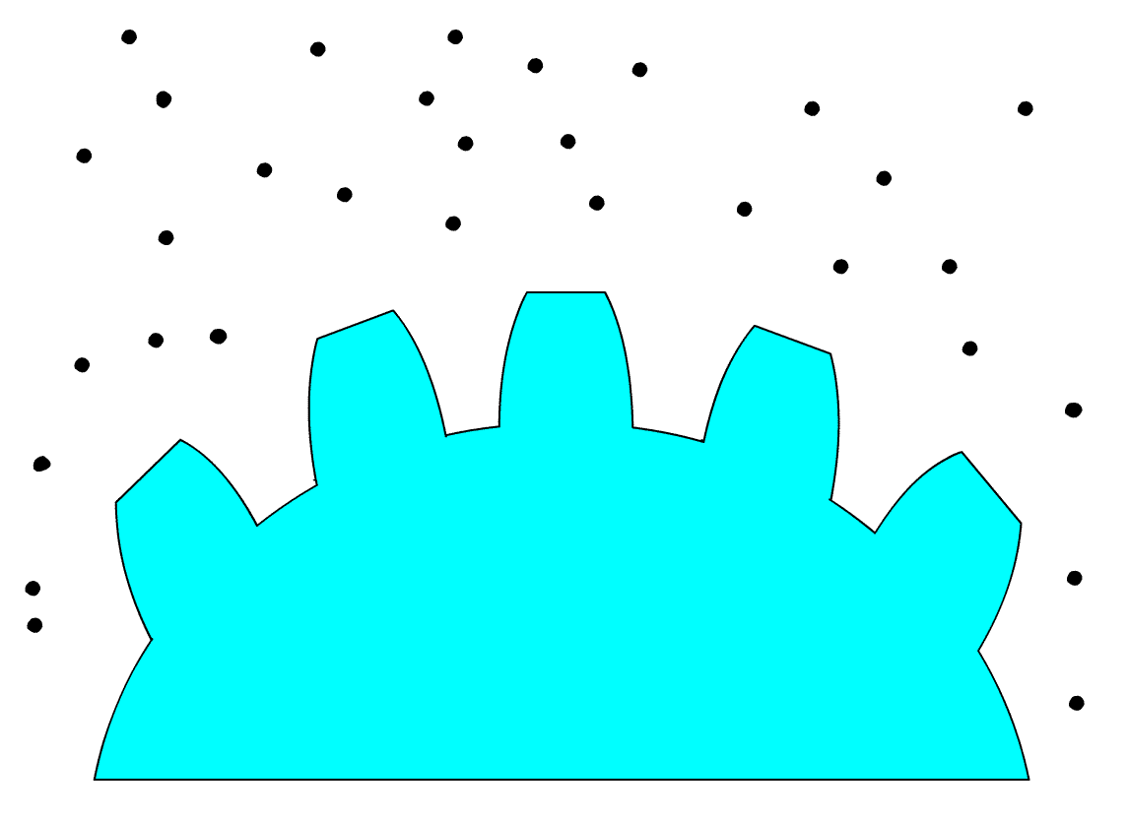
Example 2: The carburization of steel
Fig. 2.11 & 2.12
C_{i} = C_{s}
ΔC = C_{s} – C₀
Diffusing carbon atoms
Relationship between x and t

Slide 14
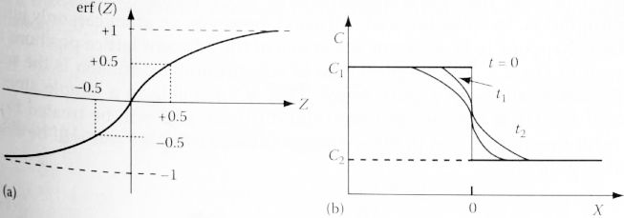
Example 3: Mutual diffusion between two rods
C₁ C₂
C_{i} = (C₁+C₂)/2
ΔC = (C₁-C₂)/2

Slide 15
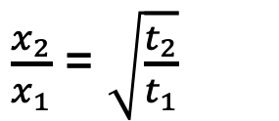
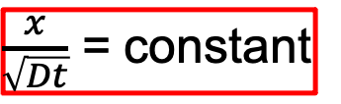
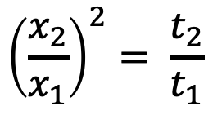
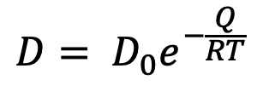
Effect of time and temperature on diffusion depth
For a fixed C,
$\frac{x}{\sqrt{Dt}}$ = constant
At a fixed T, D = constant, if you want to double the depth x, you need to use 4 times of time, i.e.
$\frac{x_{2}}{x_{1}}$ = $\sqrt{\frac{t_{2}}{t_{1}}}$
$${\left(\frac{x_{2}}{x_{1}}\right)}^{2}= \frac{t_{2}}{t_{1}}$$
$$D= D_{0}e^{−\frac{Q}{RT} }$$

Slide 16
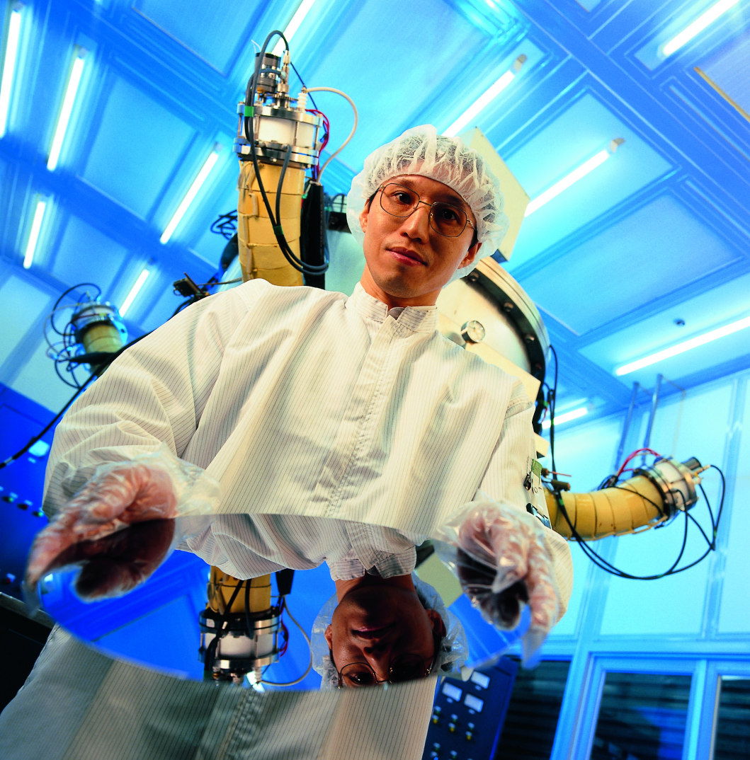
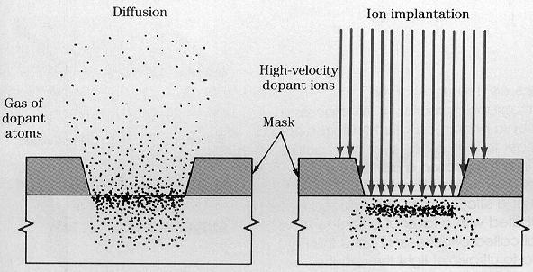

Non-steady State Diffusion
- Doping of Semiconductors

Slide 17
Home Work
Reading for this lecture:
Chapter 2.1-2.2 “Phase Transformations in Metals and Alloys”, David A. Porter et al.
HW: 2.1, 2.4,

