Slide 1
MSE 3109: Kinetic Process in Engineering Materials
Instructor: Yuntian Zhu
Office: R7182, Ph: 3442-2457
y.zhu@cityu.edu.hk
Lecture 2: Diffusion II
Notes:
Text book,
Office hour, by appointment

Slide 2
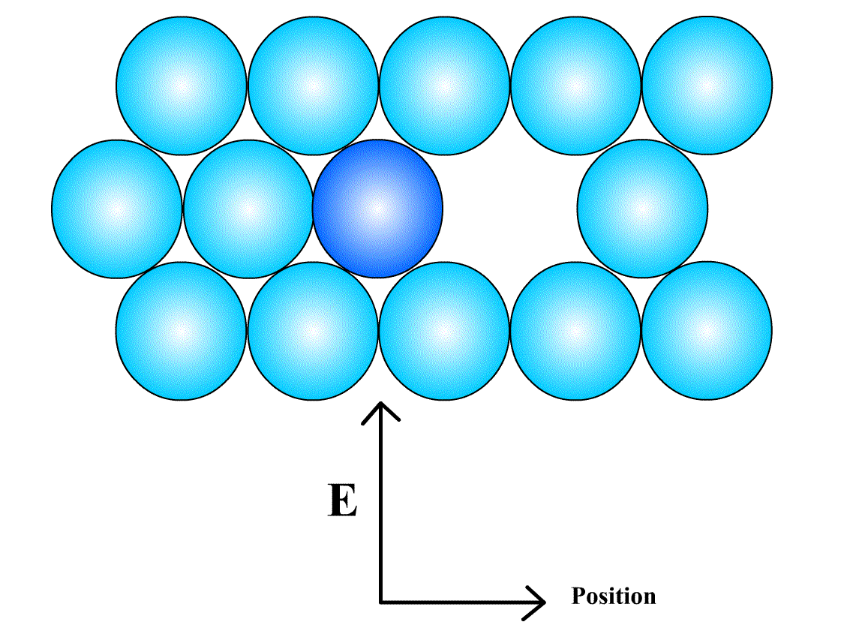

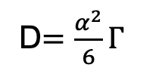
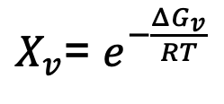

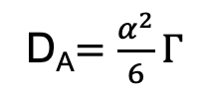
Substitutional diffusion
Interstitial diffusion
Dilute solution:
D$=\frac{α^{2}}{6}Γ$
$$Γ=zve^{−\frac{ΔG}{RT}}$$
Self Diffusion (substitutional):
D_{A}$=\frac{α^{2}}{6}Γ$
$$Γ=zXvve^{−\frac{ΔG_{m}}{RT}}$$
X_{v} is the vacancy fraction
$X_{v}$= $e^{−\frac{ΔG_{v}}{RT}}$
ΔG_{m} = ΔH_{m} -TΔS_{m}
ΔG_{v} = ΔH_{v} -TΔS_{v}
Q = ΔH_{m} + ΔH_{v}
Q is roughly proportional to T_{m}:
Q/T_{m} ~ constant for a fixed structure (Table 2.2,p83)
Notes:
The zX_{v} = available positions for the atom to jump for substitutional diffusion
Quiz: Why Q/T_{m} ~ constant?
Why bcc metal has higher D₀?

Slide 3
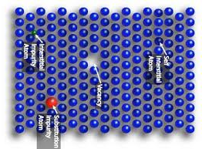
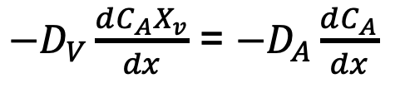
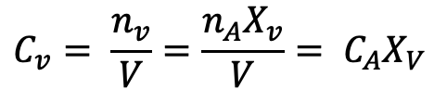
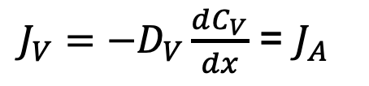
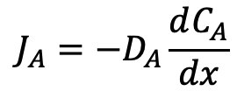
Vacancy diffusion
Self Diffusion:
X_{V} = 10⁻⁴ – 10⁻³ at T_{m}
D_{A} = D_{V}X_{V}
$$J_{A}=−D_{A}\frac{dC_{A}}{dx}$$
Same flux, different diffusion Coefficient
$J_{V}=−D_{V}\frac{dC_{V}}{dx}$ = $J_{A}$
For self or substitutional diffusion
$$C_{v}= \frac{n_{v}}{V}=\frac{n_{A}X_{v}}{V}= C_{A}X_{V}$$
Diffusion of atoms is equivalent of diffusion of vacancy to the opposite direction (flux)
Diffusion coefficient of vacancy diffusion is much higher than that of atom diffusion
$−D_{V}\frac{dC_{A}X_{v}}{dx}$ = $−D_{A}\frac{dC_{A}}{dx}$

Slide 4


Diffusion in Substitutional Alloys
A and B form an alloy
Darken’s equation
is roughly constant at T_{m}
bcc lattice has higher diffusion coefficient than fcc lattice
For dilute solution:
$X_{B}$ $→0$
$\tilde{D}$ $≈ D_{B}$
Notes:
Quiz: Why bcc lattice has higher diffusion coefficient? Density low
X_{A} ->1, X_{B}->0,

Slide 5
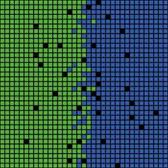

Kirkendall Effect
C₀ =C_{A}+ C_{B}
J_{A}
J_{B}
J_{V}
J_{A} = -(J_{B} + J_{V}),
A B
Cu-Zn Alloy
Notes:
D_{A} > D_{B,} D_{Zn} > D_{cu} C = n/V, Fig. 2.15 on page 88
Quiz: Why an element with lower Tm has higher D?

Slide 6
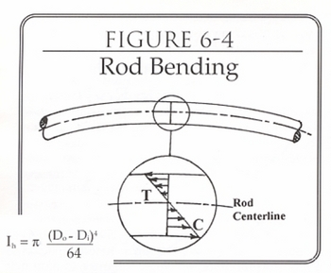
Factors affecting Diffusion direction
Strain field: Diffusion to GB and dislocations
  Implications:
Electric field
Notes:
Quiz: Can the diffusion happen if there is no composition gradient?
Diffusion of the pure metal under bending stress?

Slide 7
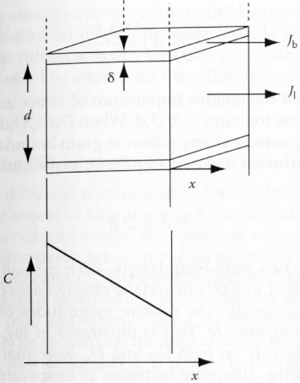
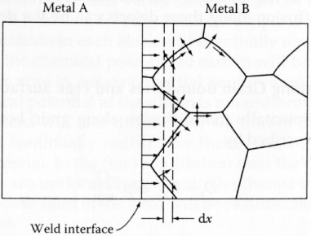
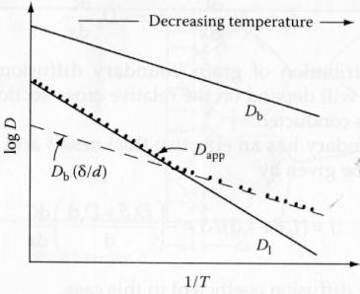
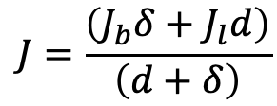
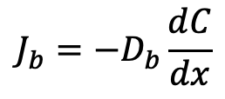
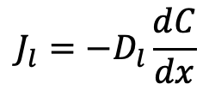
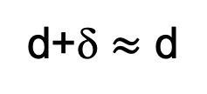
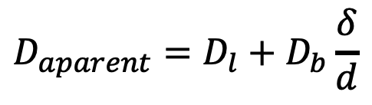
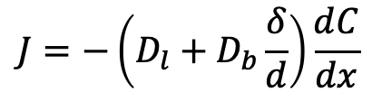
Diffusion along Grain Boundaries
Q_{b} ~ 0.5 Q_{l}
$$J_{l}=−D_{l}\frac{dC}{dx}$$
$$J_{b}=−D_{b}\frac{dC}{dx}$$
Fig. 25
$$J=\frac{\left(J_{b}δ+J_{l}d\right)}{\left(d+δ\right)}$$
d+δ $≈$ d
$$J=−\left(D_{l}+D_{b}\frac{δ}{d}\right)\frac{dC}{dx}$$
$$D_{aparent}=D_{l}+D_{b}\frac{δ}{d}$$
Temperature effect on Diffusion mechanism
Transition T=0.75-0.8 Tm
D=D₀exp(-Q/RT)
logD=logD₀-Q/RT
Notes:
Q_{b} ~ 0.5 Q_{l}
At low T: GB diffusion dominates
At high T: Lattice diffusion dominates

Slide 8
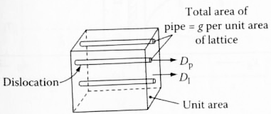
Diffusion along Dislocations
Notes:
g = 10⁻¹⁰
May become significant at low T, Derivation similar to GB effect

Slide 9
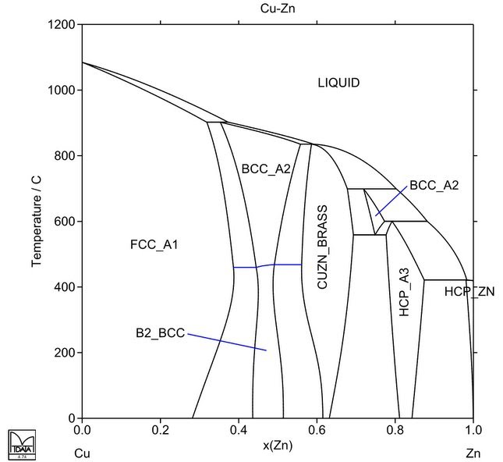
Diffusion in Multiphase Binary System
CuZn-Brass
A1
B2
A3
Zn
a
b
c
d
X (Zn)
e
f
g
h
h
g
f
e
d
c
b
a
Composition profile during diffusion
Notes:
Draw the depth-composition profile
Why there is no two-phase zone along the depth (dG/dx = 0 at two phase equilibrium prevents diffusion, no driving force)
Use an eutectic system for demo

Slide 10
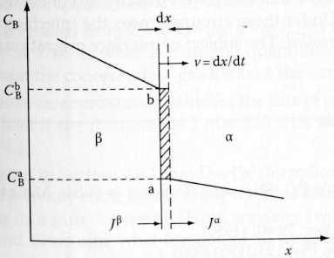
Interface speed
Notes:
Fig. 2.30

Slide 11
Home Work
Reading assignment:
  Chapter 2.3-2.8 “Phase Transformations in Metals and Alloys”, David A. Porter et al.
HW: 2.9,

